Slide 1

Course Code: MATH 211
Course Title: MATH III
Lecture 3 (Laplace Transform)
Tazin Tamanna
Lecturer in Mathematics
Department of Science and Humanities
M.Sc. in Applied Mathematics (KU)
B.Sc. in Mathematics (KU)

Slide 2
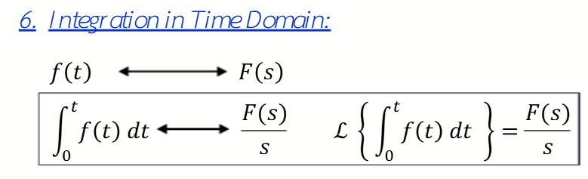
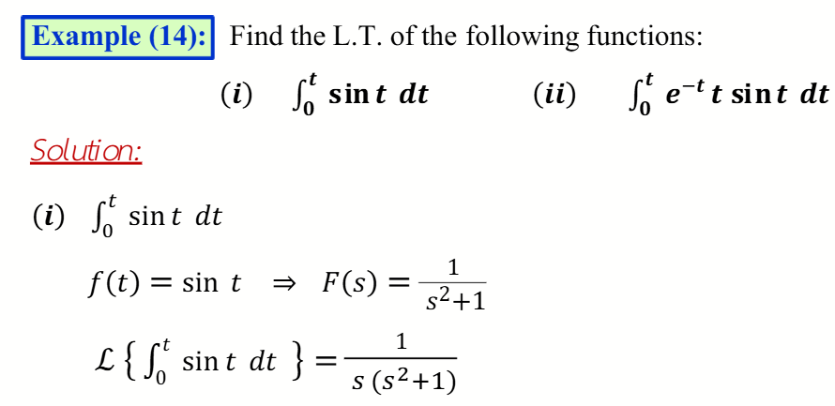
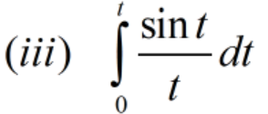

Slide 3
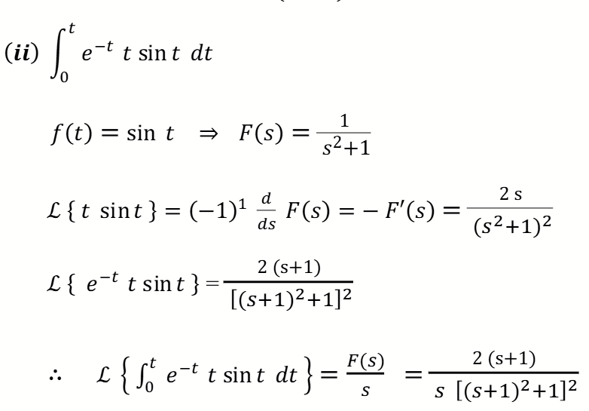

Slide 4
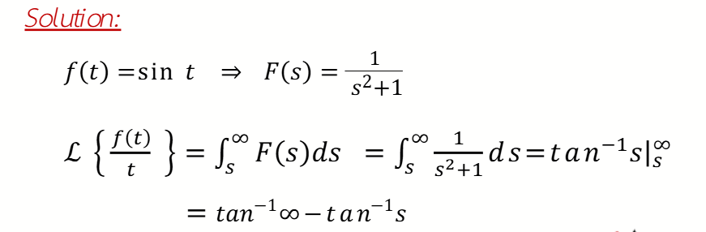

Slide 6
Do Yourself
Some Examples For Practice

Slide 7
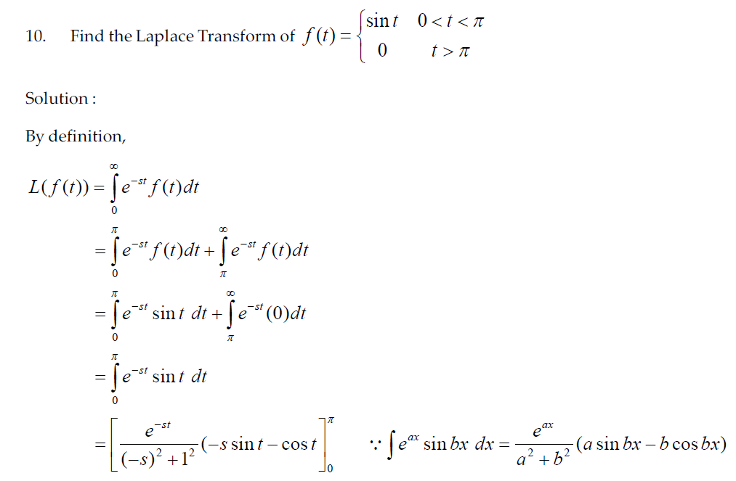
3.

Slide 8
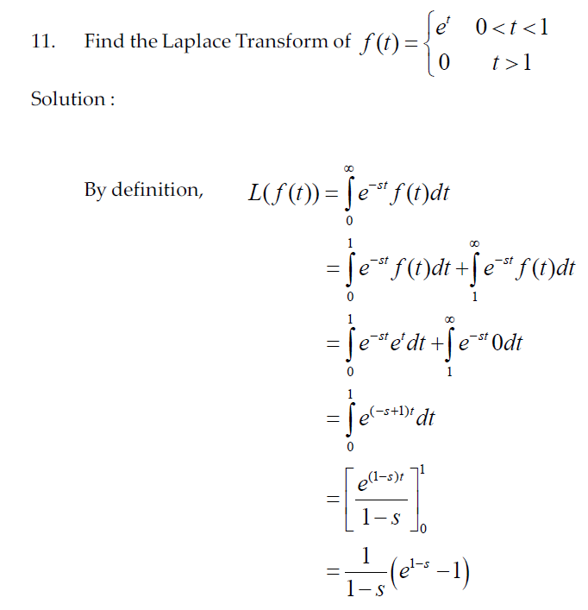
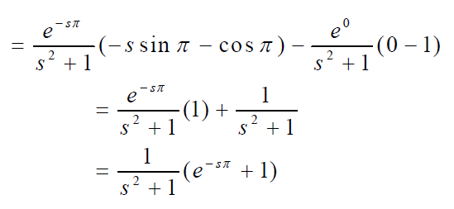
4.

